Slide 1
Longitudinal analyses of serological data
May 23, 2025
Seroanalytics Training Blantyre, Malawi

Slide 2
Outline
Longitudinal data
Antibody kinetics
Value of analyses of quantitative titers

Slide 3
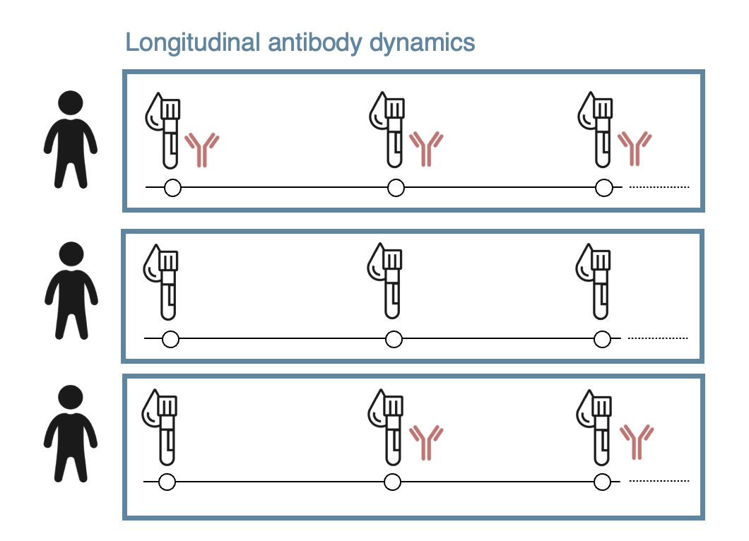
Reminder: longitudinal data (From Lecture 0)
Repeated samples from the same individuals
Could be days, weeks, months, years apart
Could span various time periods

Slide 4
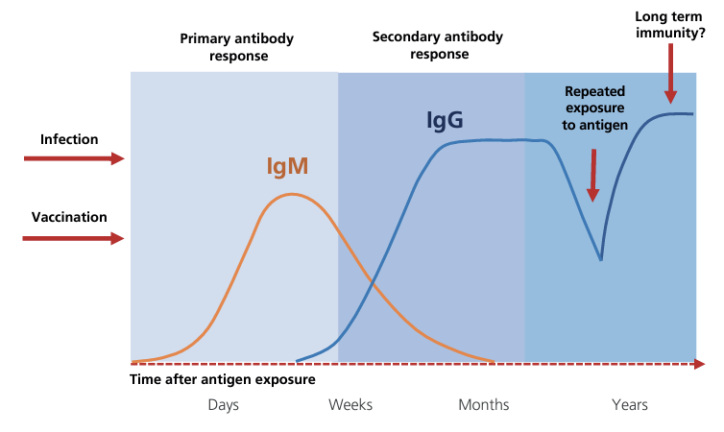
Antibody kinetics
Titers from individual people within cross sectional survey
Titers from same person from a longitudinal survey

Slide 5
Binary serostatus often does not tell the full story
Titers from same person from a longitudinal survey
Protective
threshold

Slide 6
Binary serostatus often does not tell the full story
Titers from same person from a longitudinal survey
Protective
threshold

Slide 7
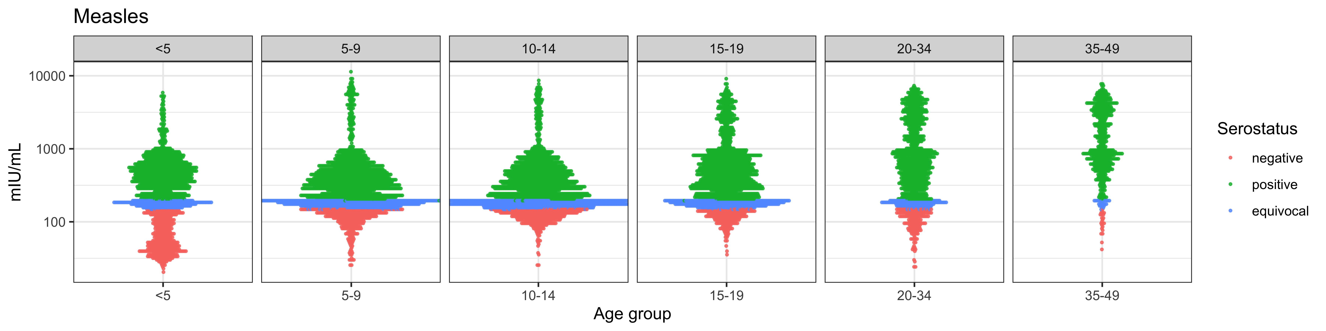
Even without longitudinal data, there is still value in analyzing quantitative titers
Carcelen, Winter, et al. (2022) Sci Reports.

Slide 8
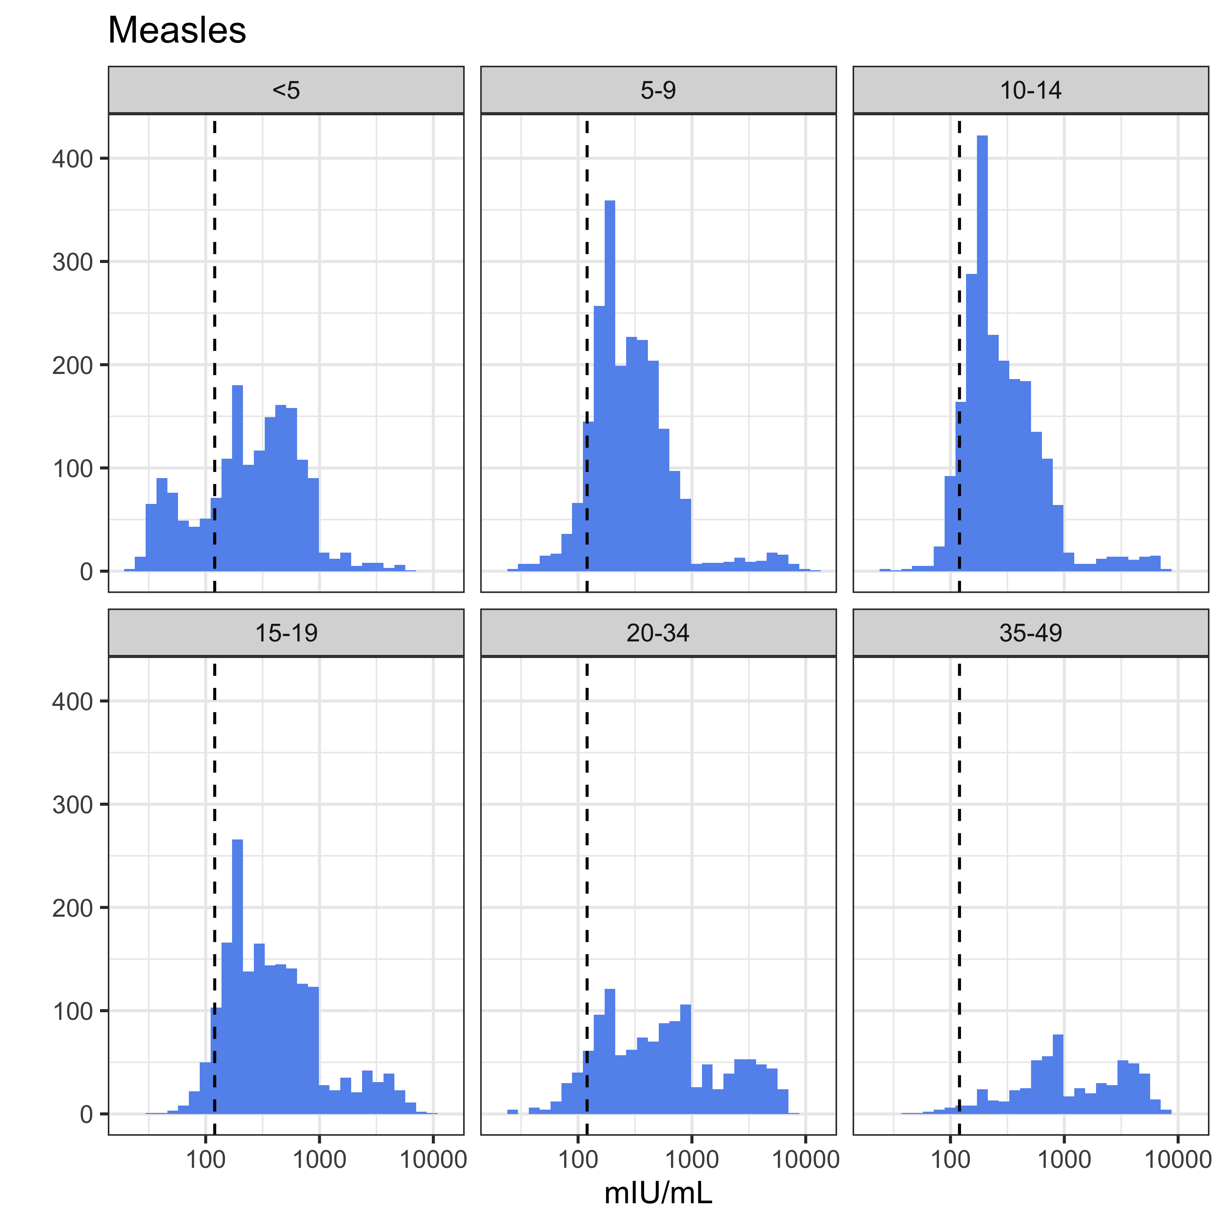
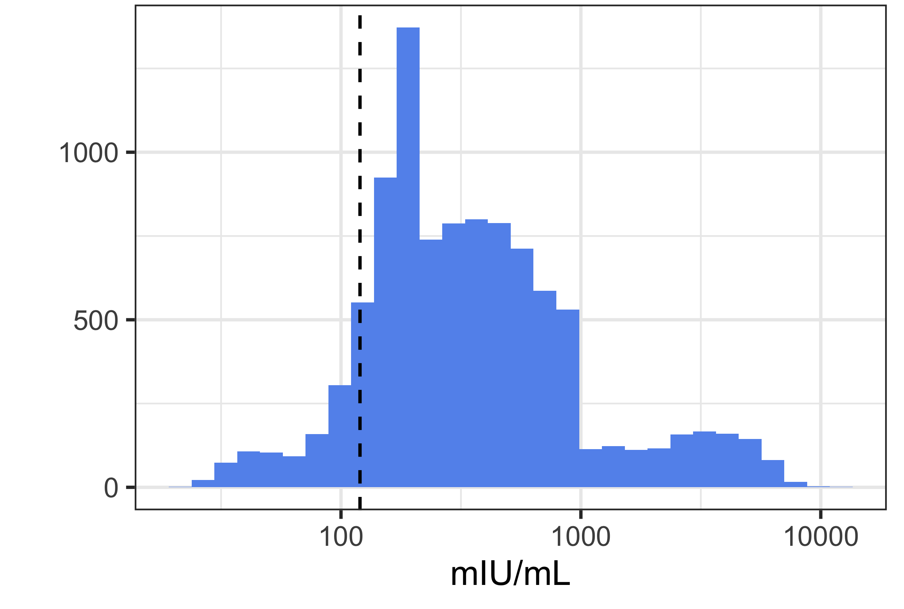
Even without longitudinal data, there is still value in analyzing quantitative titers
Carcelen, Winter, et al. (2022) Sci Reports.

Slide 9
Longitudinal data can help us analyze…
Initial response to infection/vaccination
Incidence and time-since-infection (TSI)
Boosting (from exposure or vaccination)
Waning or decay

Slide 10
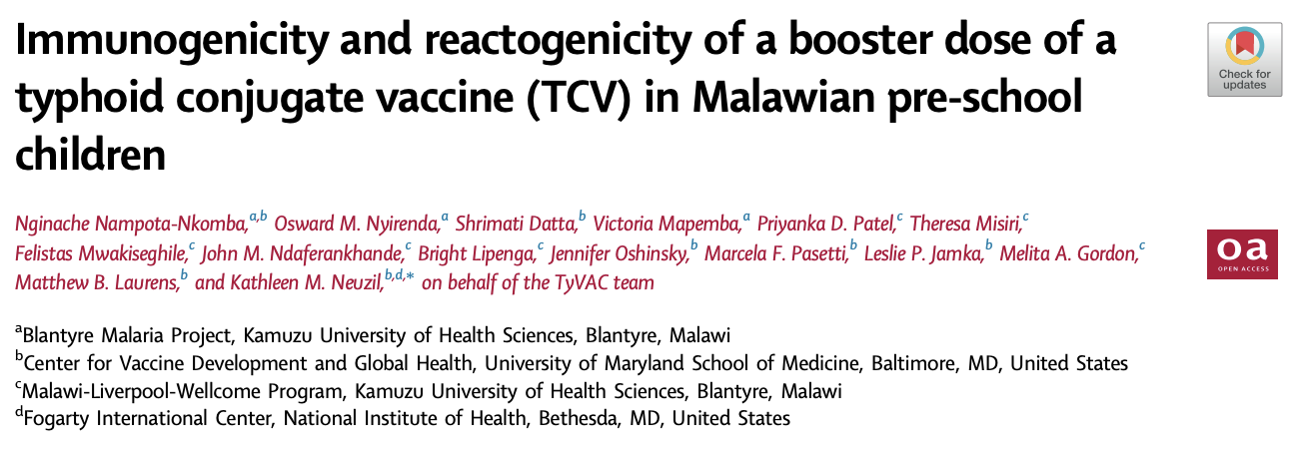
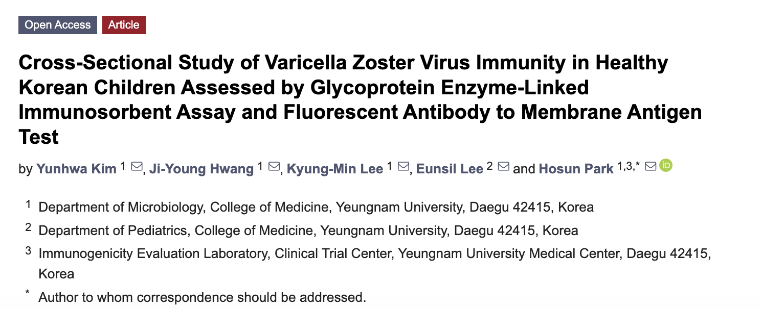
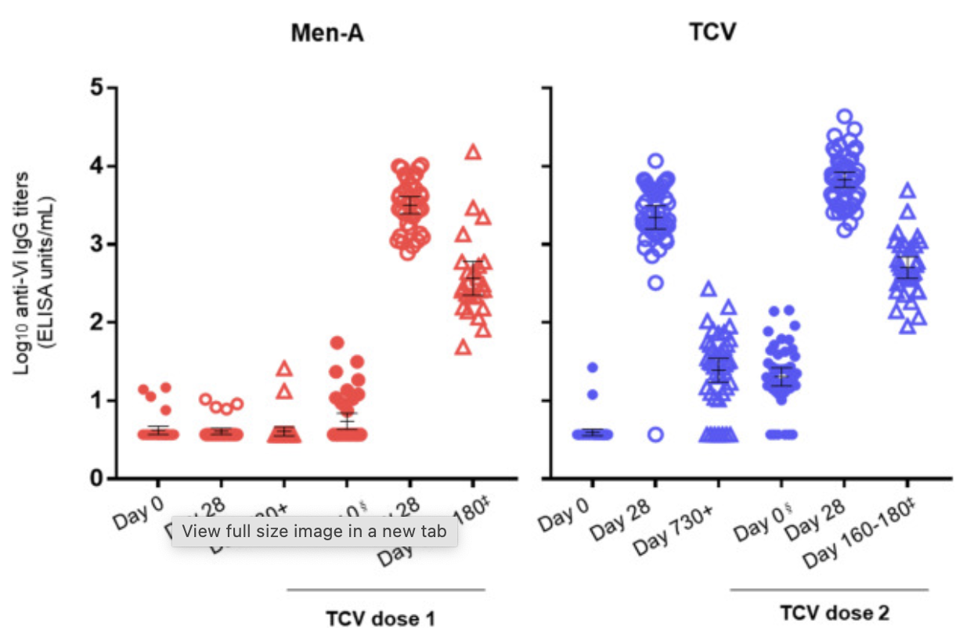
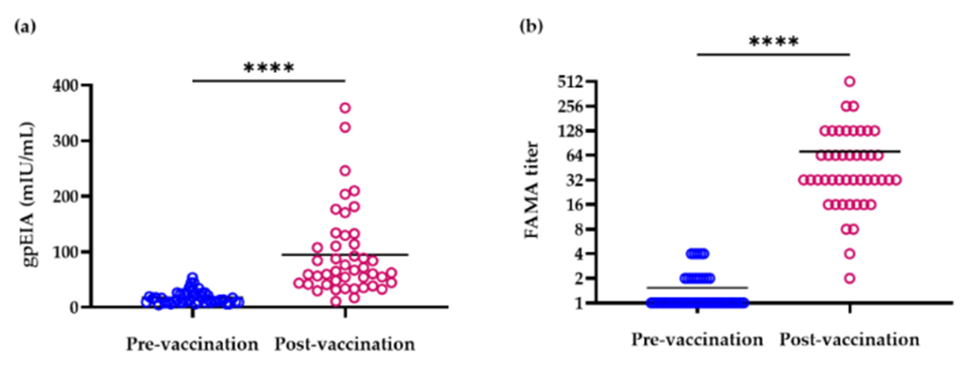
Initial response to infection / vaccination Including immunogenicity studies
Notes:
Typhoid- vi
VaccZymeTM VZV glycoprotein

Slide 11
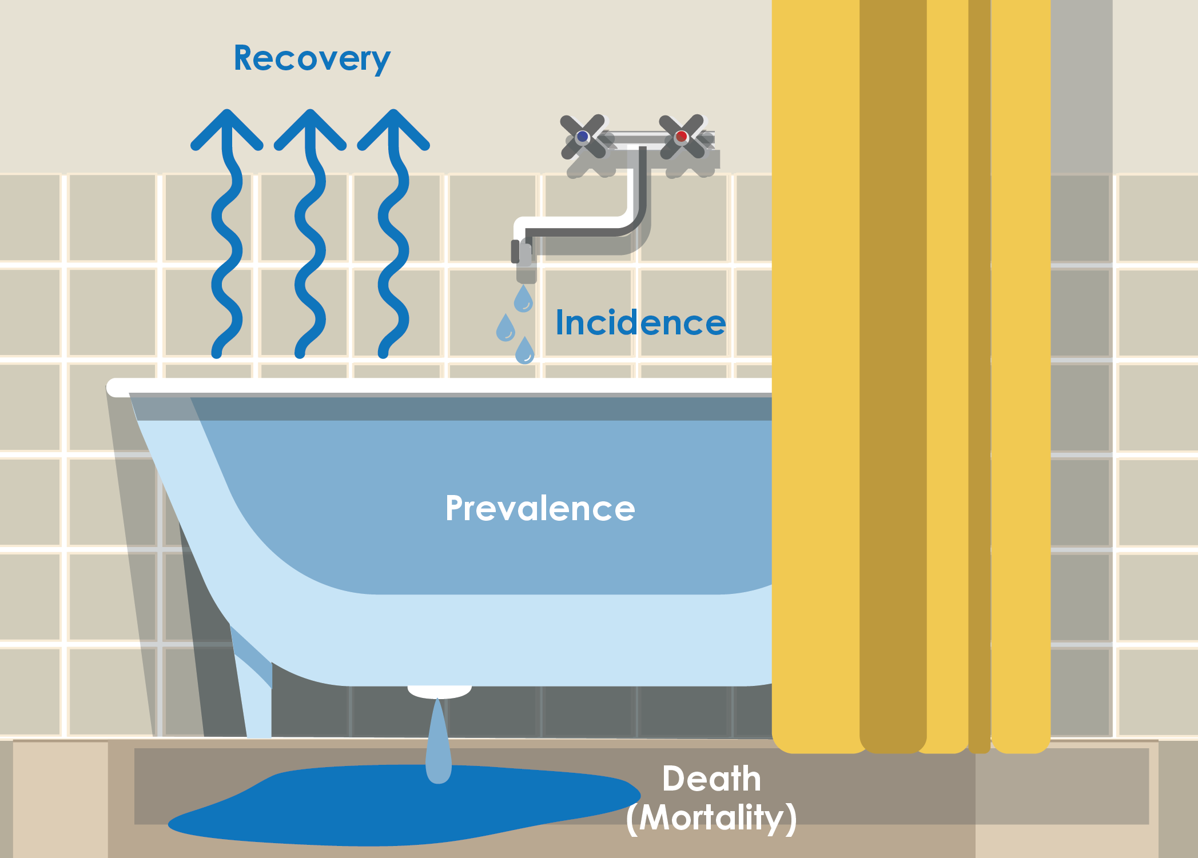
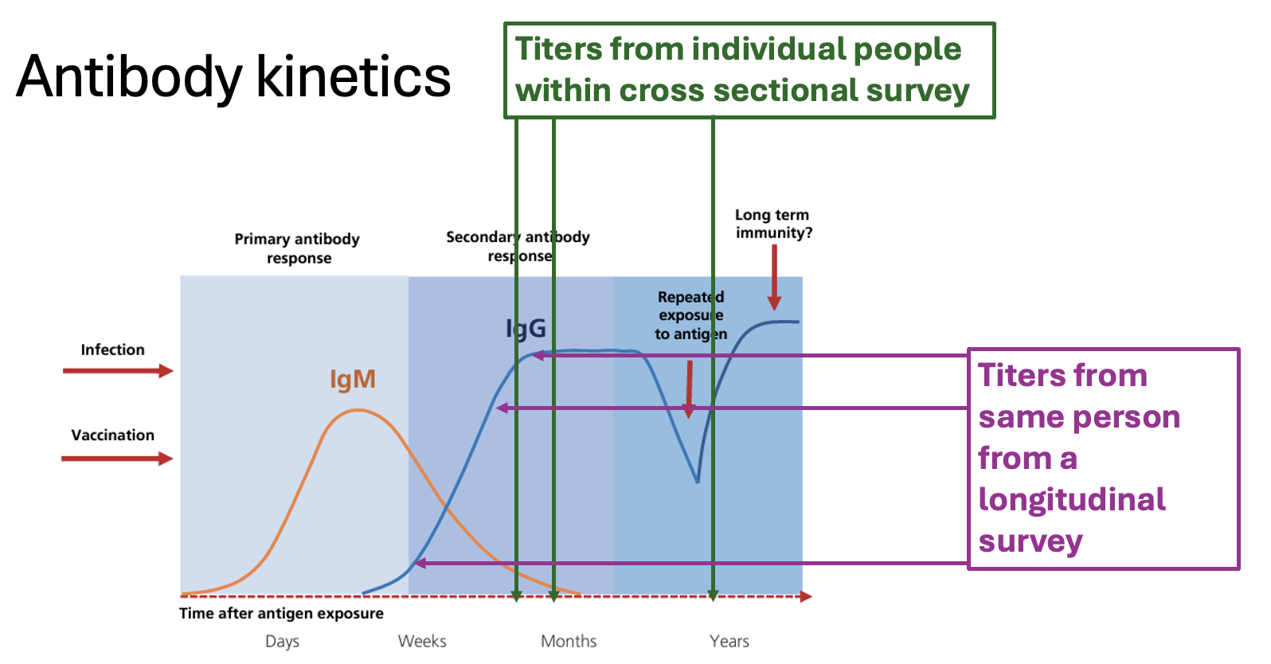
Seroincidence estimation
Cross sectional data can show us the proportion of people seropositive / above some threshold at any given time
This is a metric of prevalence
Longitudinal data can show us changes within individuals in the population which allows us to estimate new infection/exposure
This is a metric of incidence

Slide 12
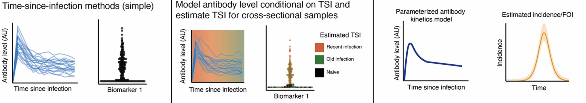
Time-since-infection (TSI)
Use mathematical model to predict antibody level as a function of TSI (or vaccination)
Requires longitudinal samples following known exposure
Can use information from one or more antigens / biomarkers simultaneously

Slide 13
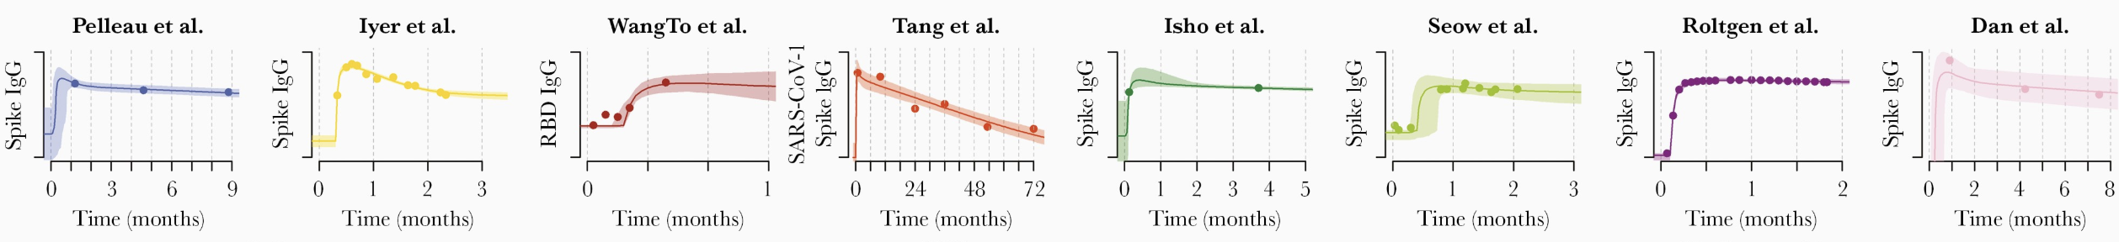
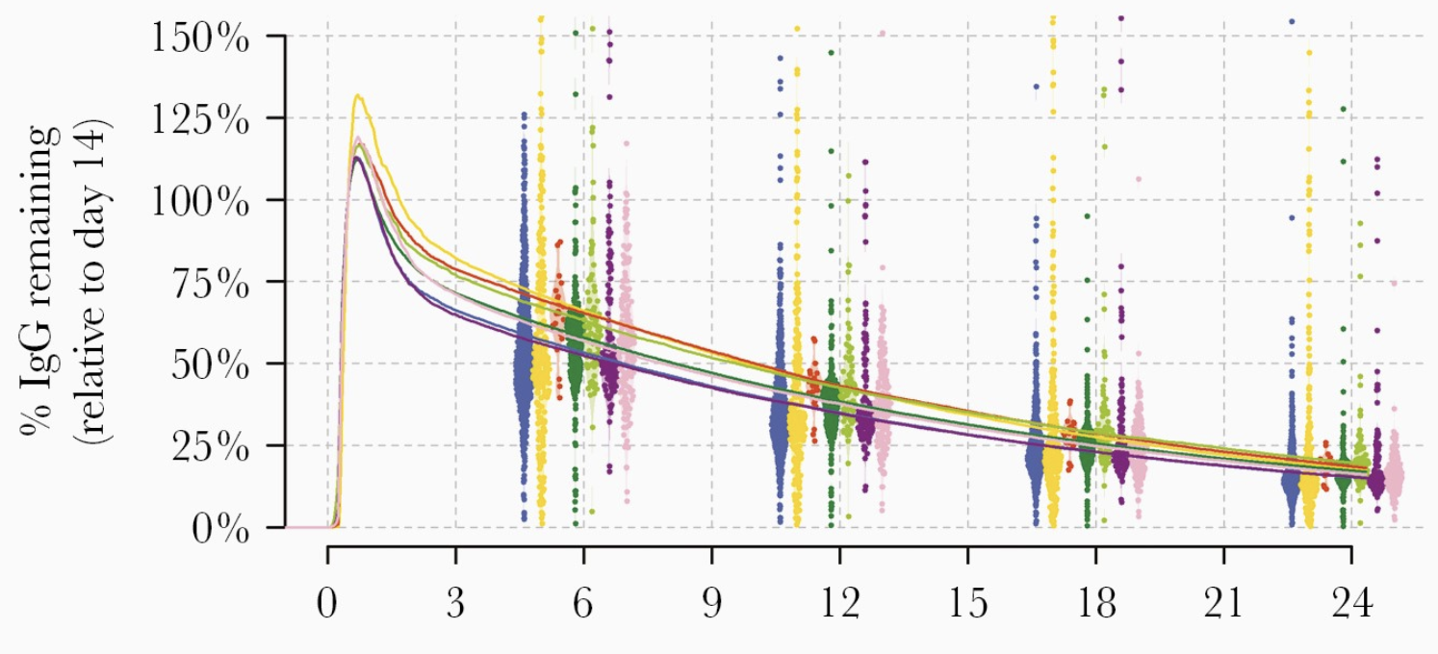
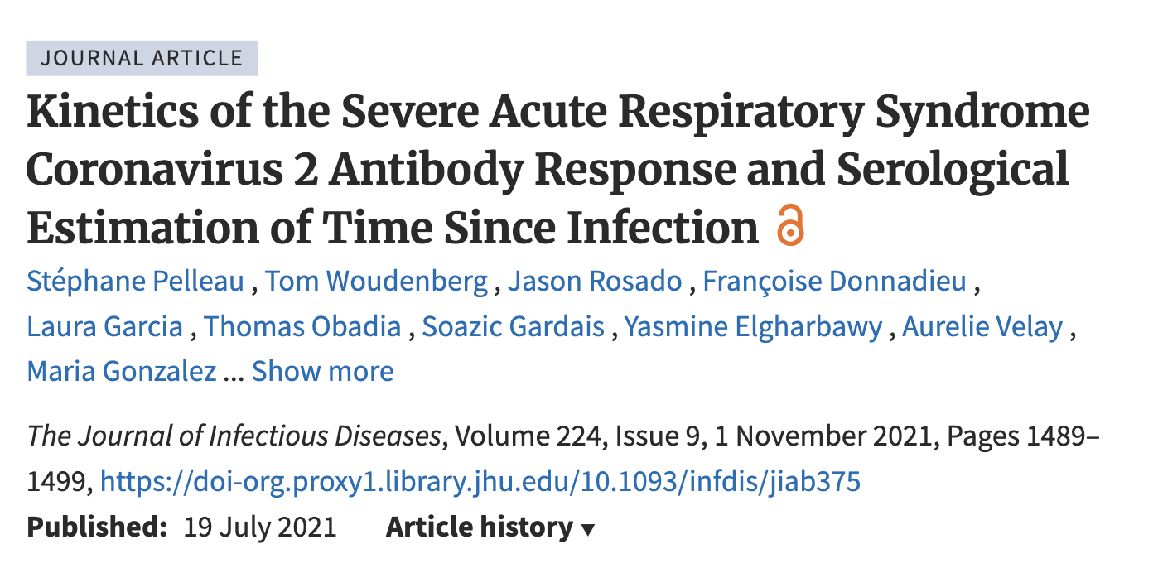
Example: TSI
Notes:
Data from France, multiple SARS-CoV-2 biomarkers (spike here, but could also go on to combine information from also RBD and nucleocapsid )

Slide 14
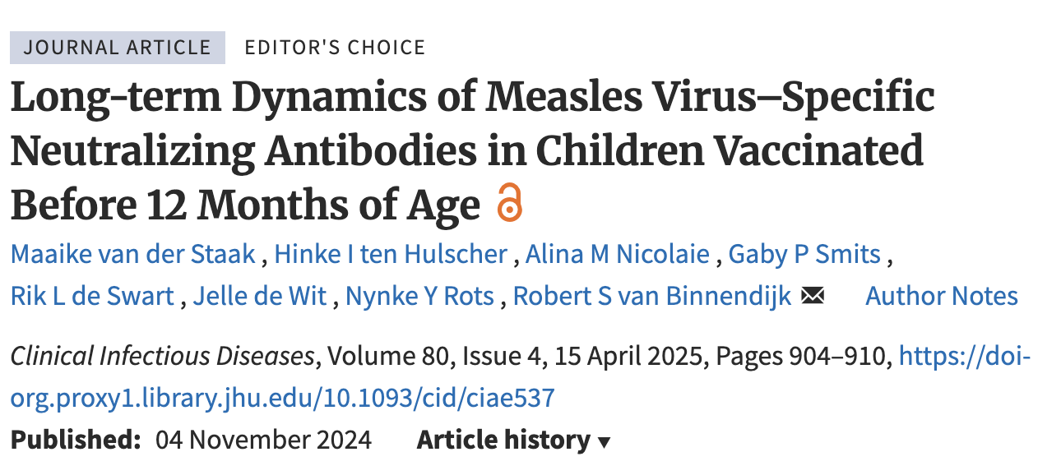
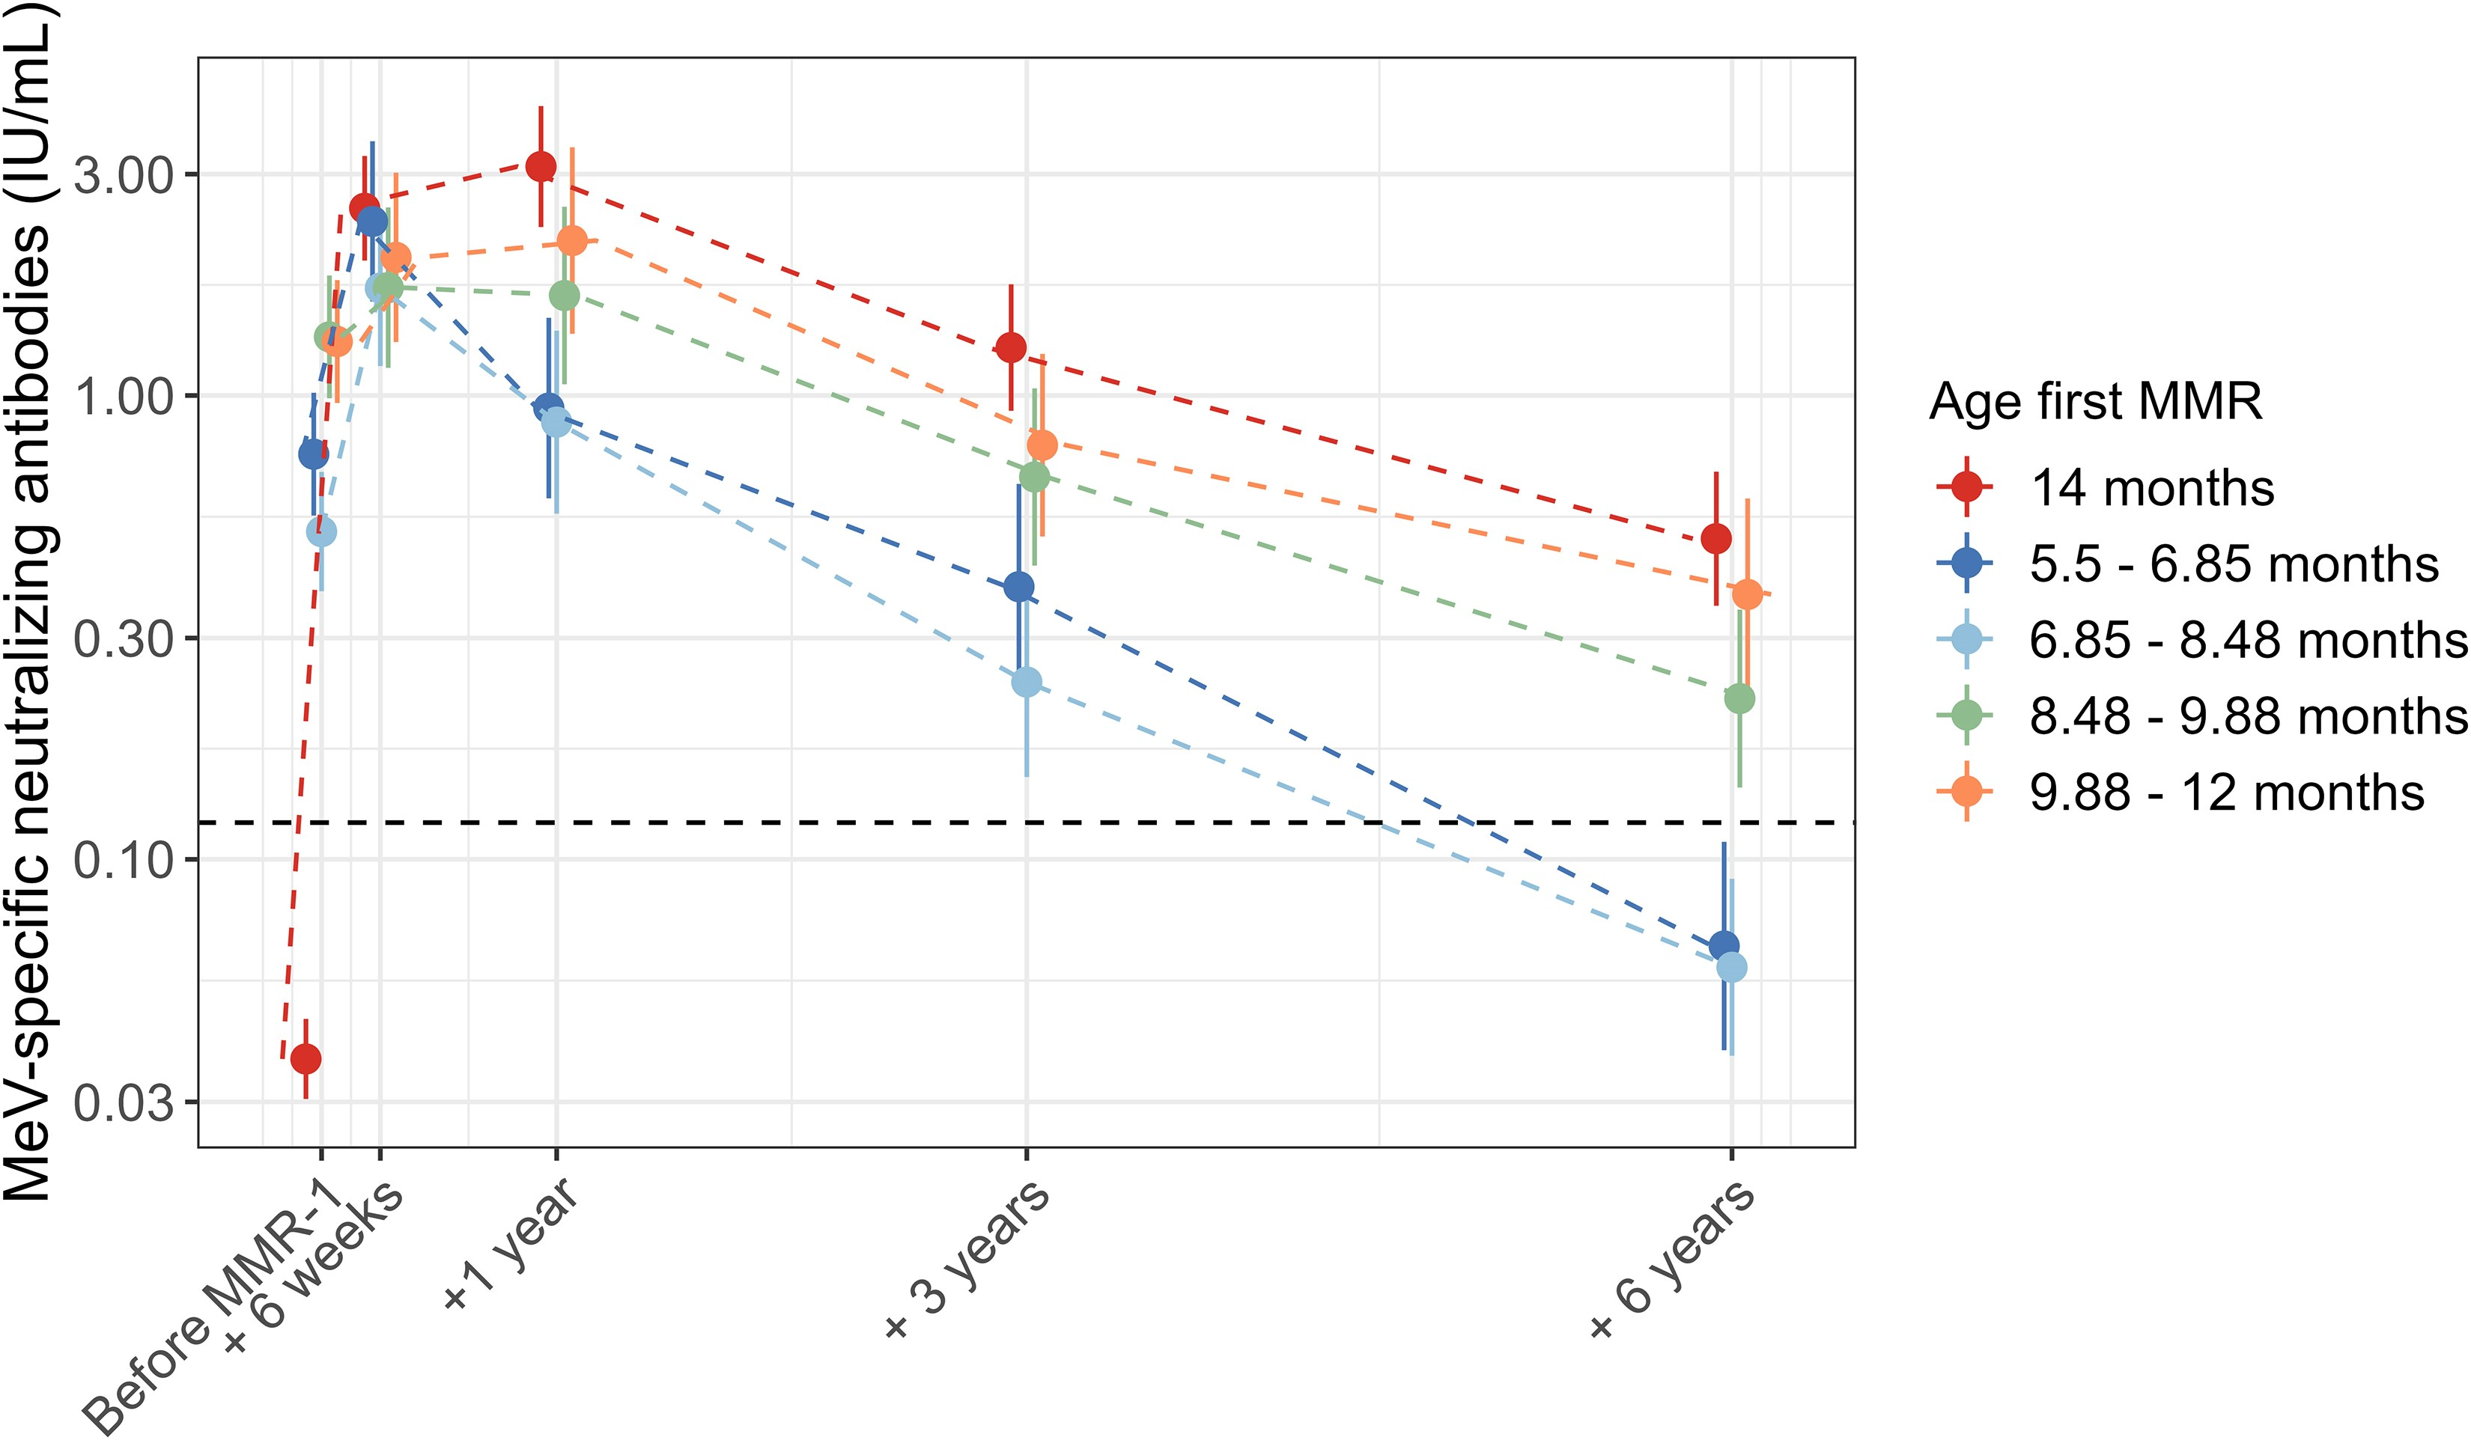
Boosting
Can use kinetics to understand rate of boosting following vaccination or infection
Additionally, asymptomatic cases or carriage
(MMR-0)

Slide 15
Waning models
Linear
Exponential
Power, etc…
log(IU/mL)
IU/mL
Time / Age
log(IU/mL)
IU/mL
Time / Age
Time / Age
log(Time / Age)

Slide 16
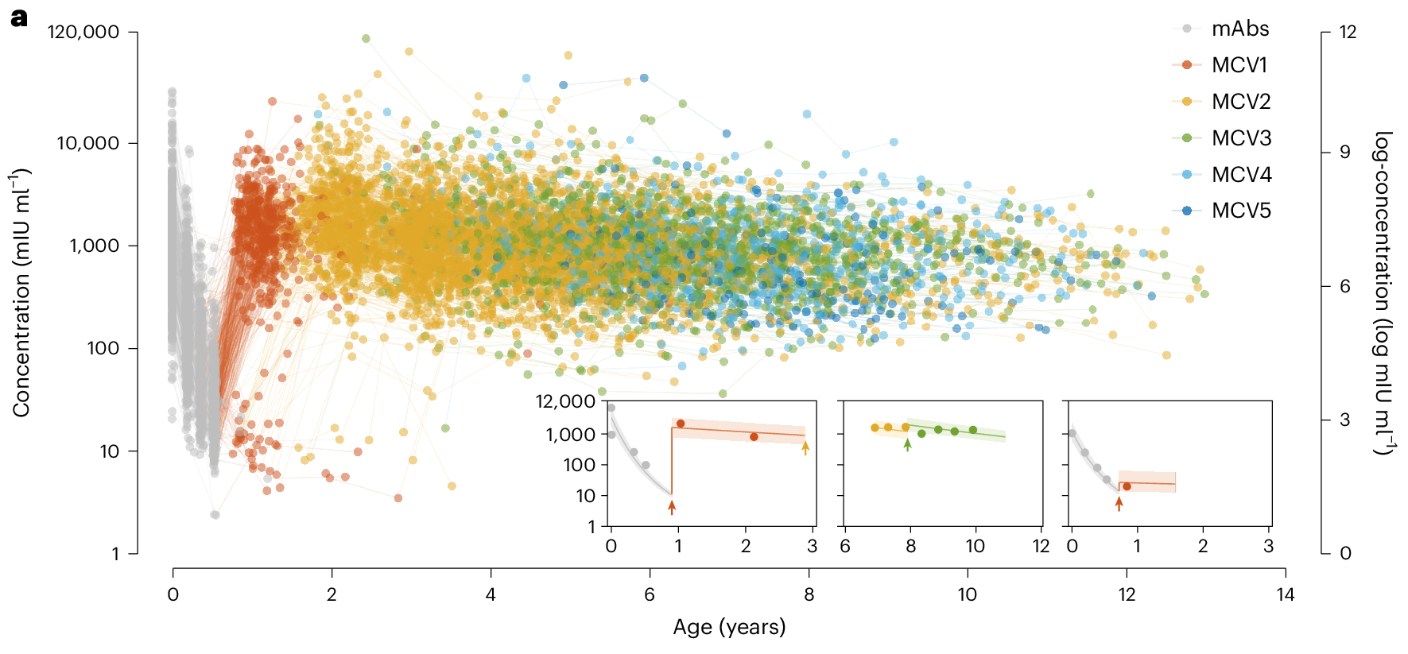
Application: Longitudinal VPD titers
Decay expected, but infrequently quantified
Explicit mechanisms affecting rate of decay hypothesized but also not often quantified (especially in low- and middle-income settings)
Declining measles titers (IU/mL) across age:
2 years: 1465 (1353 – 1604)
5 years: 889 (837 – 953)
8 years: 645 (584 – 713)
Current titer related to maternal antibody concentration and date of vaccination
Did not examine additional factors that might influence rate of decay (e.g., nutritional status)
Wang W, et al. Nat Microbiol (2024). DOI:10.1038/s41564-024-01694-x
Notes:
Across vaccine preventable diseases (or VPDs), It is known and expected that immune responses to vaccines wane / decline over time,
However, the magnitude of this decay or factors that might influence this decay, while hypothesized, are largely unquantified
Particularly, most proposed mechanisms often most heavily impact low- and middle-income countries.
For example, a recent paper published in Nature Microbiology examined waning measles antibody titers from longitudinal cohorts of paired mothers and children from China.
They observed these expected declining titers by age and examined factors such as maternal antibody concentration and date of vaccination and how they both may predict titer level by age.
However, they did not examine any other additional factors that might influence this decay rate, like nutritional status or other immune function.

Slide 17
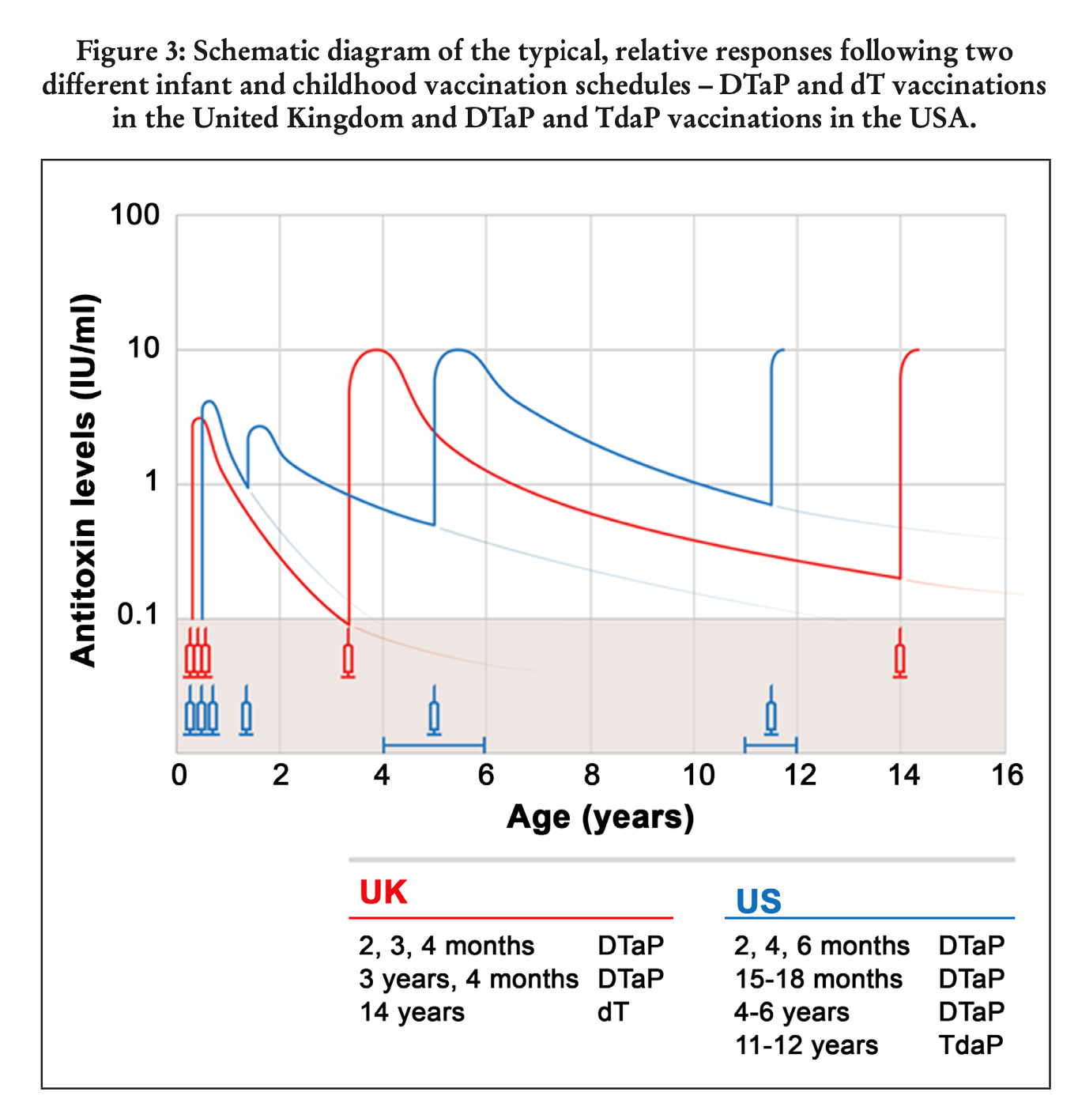
Longitudinal tetanus titers
Tetanus primary series: 3 doses before age 6 months
Substantial waning expected
WHO recommends 3 boosters
Prevent outbreaks
Achieve and maintain maternal and neonatal tetanus elimination (MNTE)
Relatively low cost (between $0.40 - $1.49 for all boosters per child)
EPI programs per country determine booster schedule
WHO Immunological Basis for Immunization Series Module 3: Tetanus (Update 2018)
https://immunizationdata.who.int/docs/librariesprovider21/additional-datasets/jrfpresentation-dtp-who-trimmed-041521-final.pptx
Notes:
Tetanus vaccination currently recommended in a 3 dose schedule before age 6 months.
Because of substantial expected antibody waning, WHO recommends 3 booster doses be administered to ensure protection and contribute to reduced tetanus incidence and fewer outbreaks, and achieve and maintain maternal and neonatal tetanus elimination.
Vaccination programs in each country set their own schedule for both primary and booster tetanus vaccination, which vary non-trivially between regions.
Many LMICs use a 6.10.14 week schedule for their primary dose series, but have very different schedules for booster doses.

Slide 18
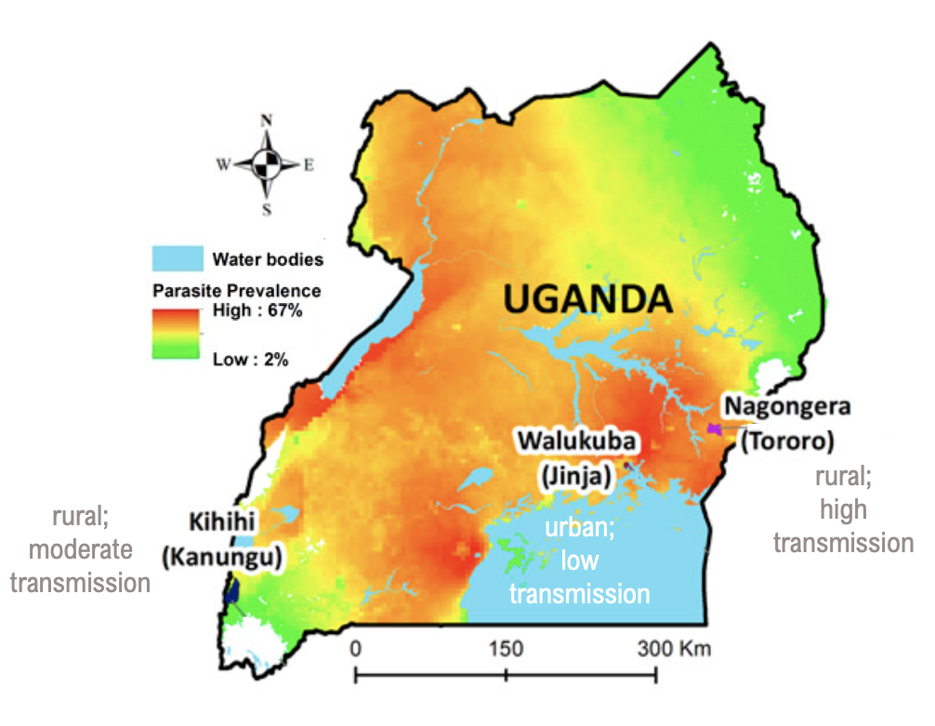
Application: assessing tetanus antibody decay
Program for Resistance, Immunology, Surveillance, and Modelling of Malaria (PRISM)
Longitudinal cohort with quarterly sampling
Objective: characterize tetanus antibody waning overall and by key study characteristics
Kamya, et al. (2015) AJTMH.

Slide 19
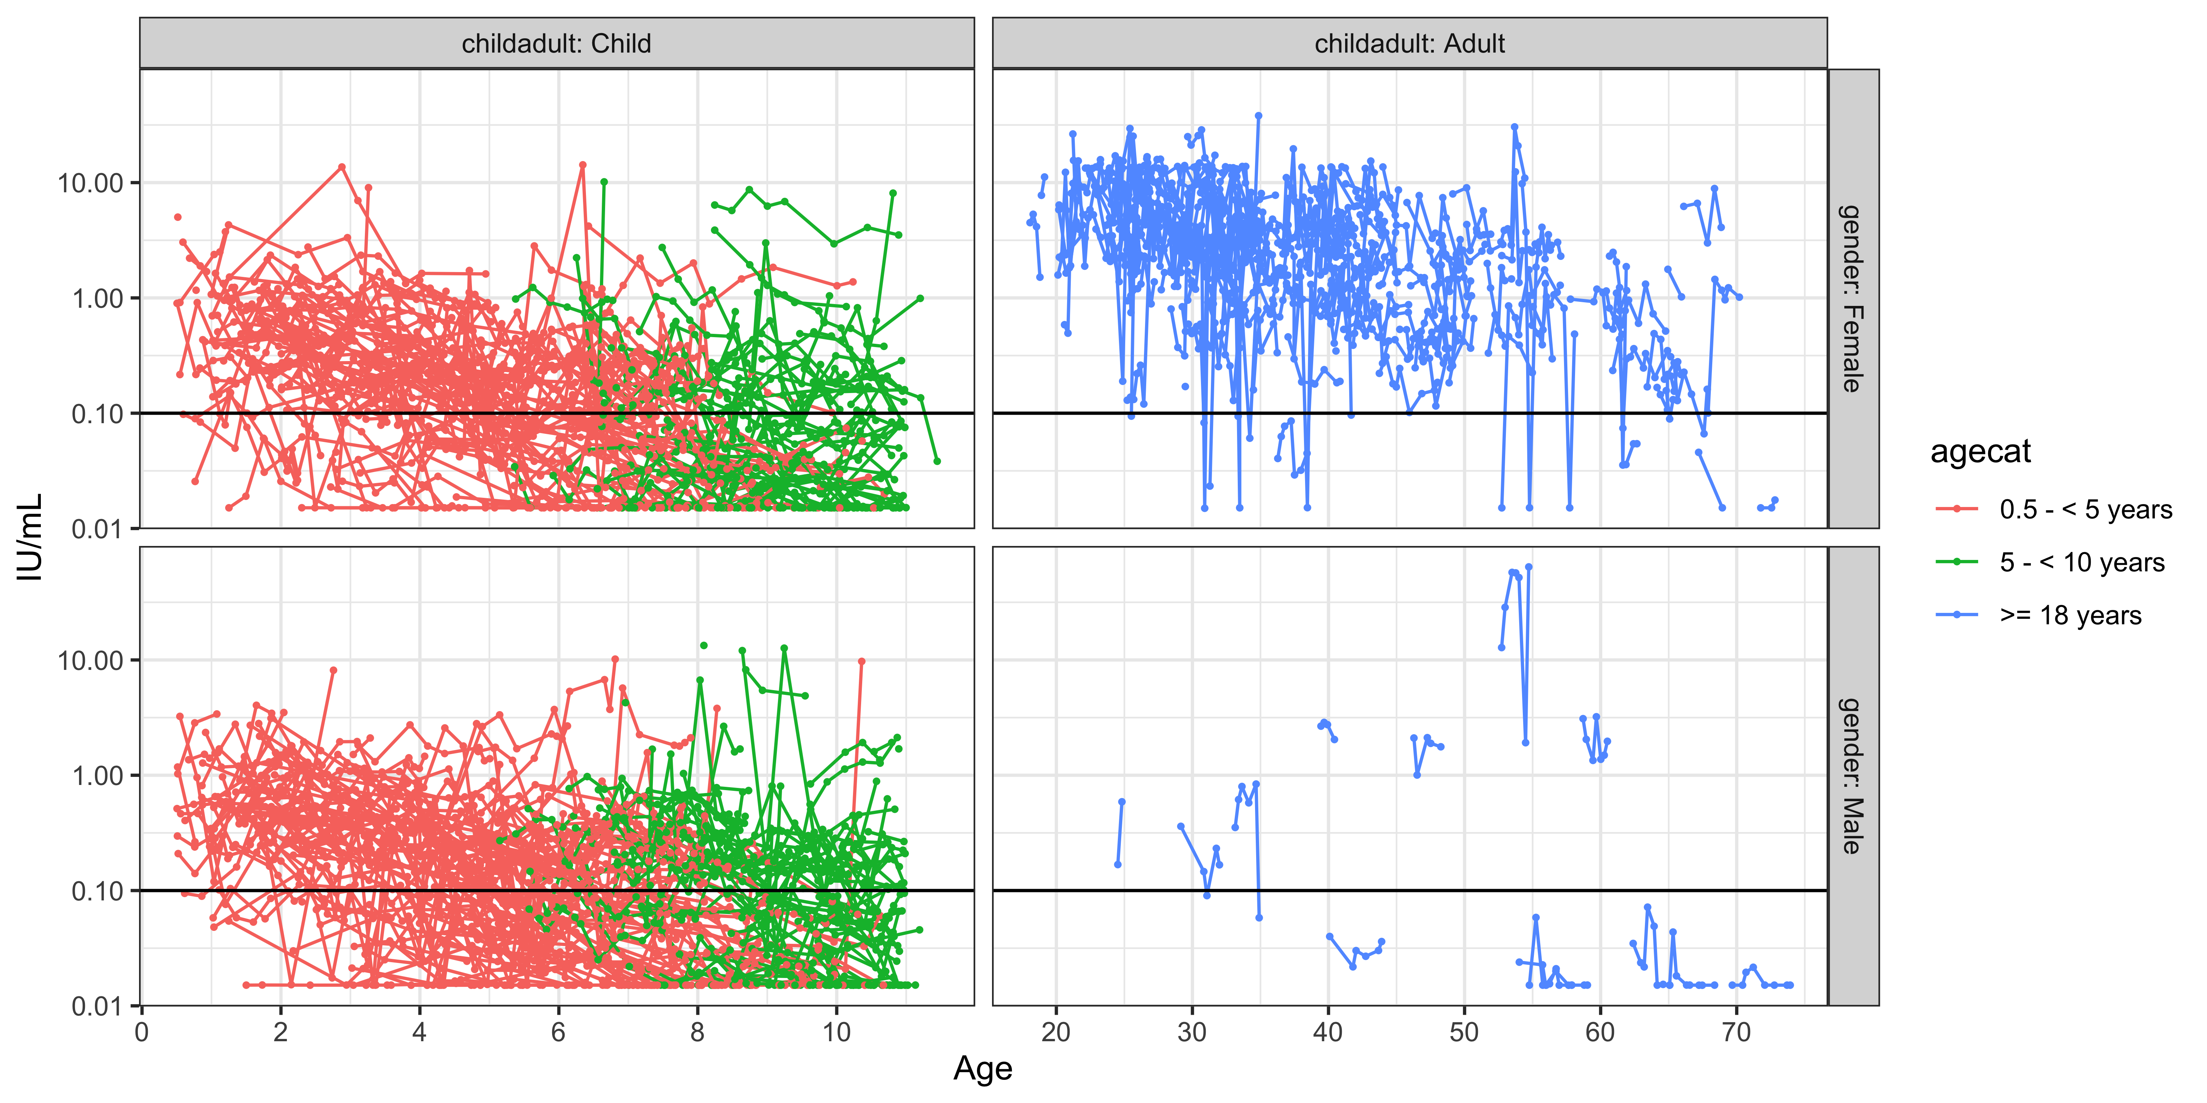
Seroprotective
threshold
Seroprotective
threshold
Sbarra, et al. (in preparation)

Slide 20
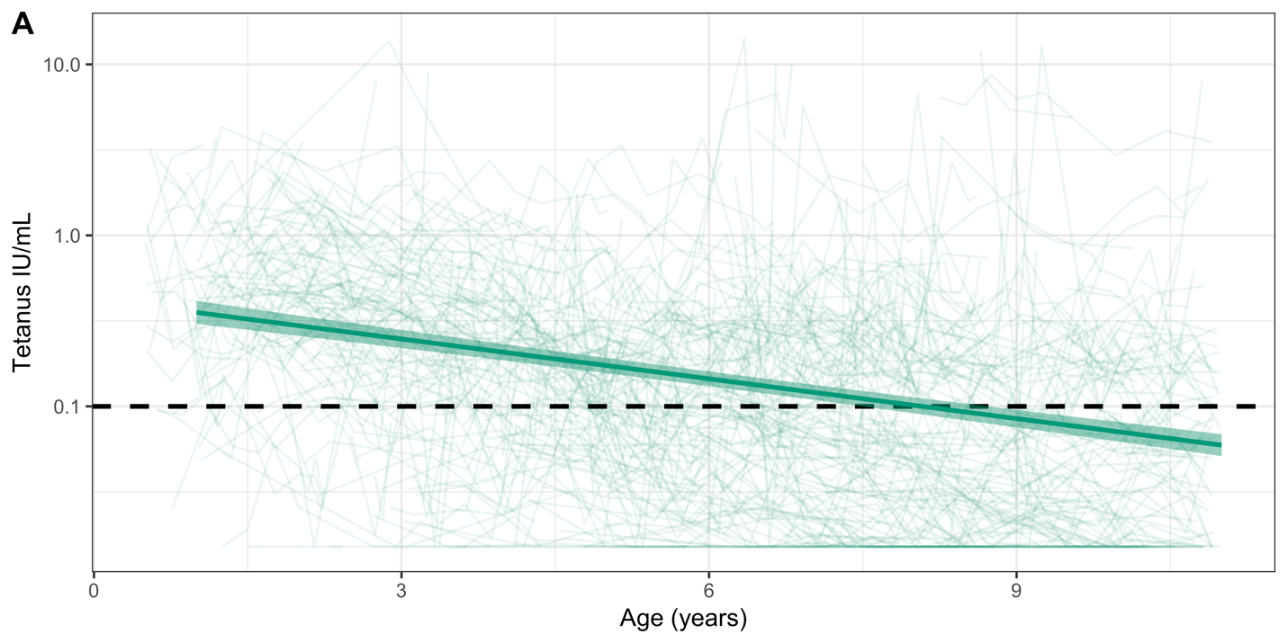
Tetanus antibody decay
Half-life of antibody titers is 3.9 years (95% CI: 3.5–4.4 years).
Estimated age of sero-reversion is 8.1-years-old (95% CI: 7.2- to 9.2-years-old).
Sbarra, et al. (in preparation)
Notes:
Overall, the tetanus antibody titer half-life was estimated to be 3.9 years (95% confidence interval (CI): 3.5–4.4 years); the estimated age of sero-reversion is 8.1-years-old (95% CI: 7.2- to 9.2-years-old).

Slide 21
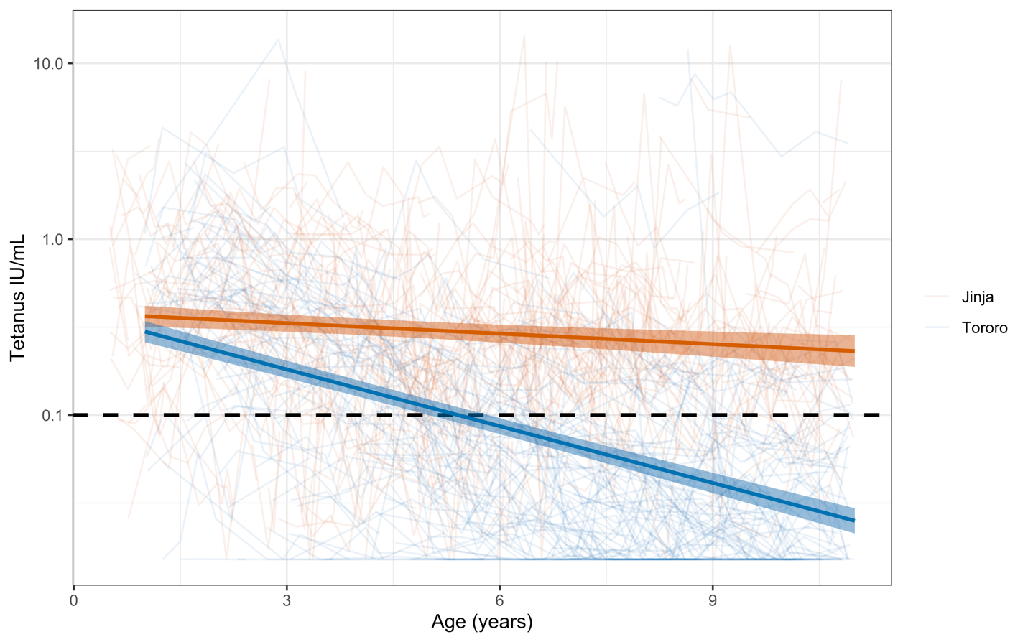
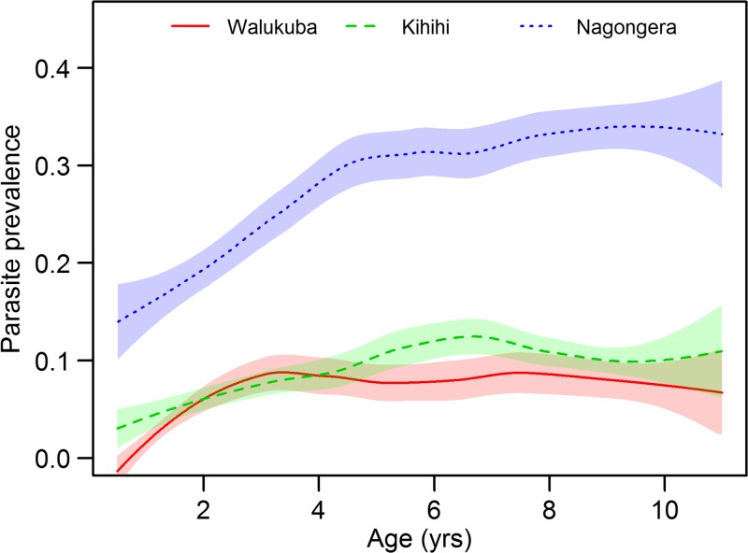
Decay by study site
Tororo
Jinja
Kamya MR, et al. Am J Trop Med Hyg (2015).
Half-life of tetanus antibody titers in Jinja (15.2 years [95% CI: 9.7 to 34.6 years]) is statistically more than in Tororo (2.8 years [95% CI: 2.6 to 3.1 years])).
Sbarra, et al. (in preparation)

Slide 22
We can still consider the correlate of protection when evaluating longitudinal data
 | Jinja | Tororo | Total
Sero-reversion event during study period | 37 | 52 | 89
No sero-reversion event during study period | 161 | 70 | 231
Total | 198 | 122 | 320
Hazard model: estimates the probability that an event will occur during a specified time period
Among children who were seropositive at the start of the study period, there was a 2.35 (95% CI: 1.53 to 3.62) times increased risk of sero-reversion in Tororo relative to Jinja (p < 0.001).
Sbarra, et al. (in preparation)

Slide 23
Questions?

